Slide 1
Sales Data Analysis
Summary Of Insights From Analysis
Chandramouleshwar J
25/09/2025

Slide 2
Introduction
Brief About The Dataset:
I have considered “store_data.csv” file which is a dataset of the orders and shipments that have taken place in the country United States.
The dataset comprises of various columns and mainly has: Sales amount, Category, Segment, Region, City, State,. Etc.
The dataset also contains the shipment and order dates too with the customer names and IDs.
Objective Of Analysis:
The main objective of Analysis is to find the total sales amount of the overall transactions.
To find the year-wise orders placed and the shipments done.
To assess how soon the delivery is done and also to make sure the lack of availability.
Considering all the KPIs and Performance Indicators to make a better decision making of improving the stores affordability.

Slide 3
Data Preparation
Steps taken before visualisation:
Downloaded the dataset from Kaggle: [https://www.kaggle.com/datasets/rohitsahoo/sales-forecasting]
Open Power BI application and click Get Data
Depending upon the format of the dataset, select the file extension in the dropdown list.
Analyse the data and find whether is there any duplicate values or null values present in the dataset.
After removing the nulls, export the dataset into the Power BI from Power Query Editor.
If any date columns are present in the dataset, create a date table additionally by the help of CALENDAR() DAX measure.
Create a relationship between Date Table and the column which has the dates.

Slide 4
Key Metrics (KPIs)
DAX Measures:
Total Sales
LeastShipmentTime
MaxOrderDate
MinOrderDate
MaxShipDate
MinShipDate

Slide 5
Key Metrics (KPIs)
Calculated Columns:
Order_Month_Year
Ship_Month_Year
Order_Year
Ship_Year

Slide 6
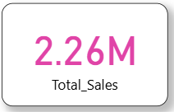
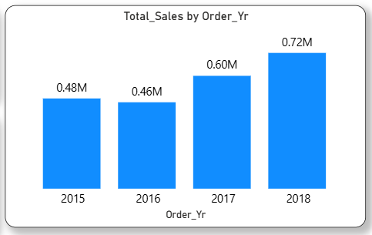
Understanding Of Visuals
Total Sales
Total Sales By Order Year

Slide 7
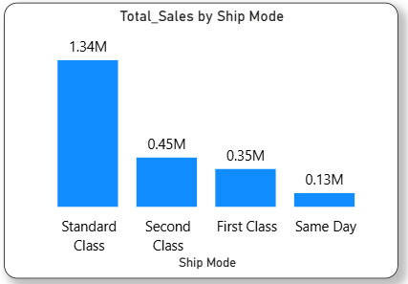
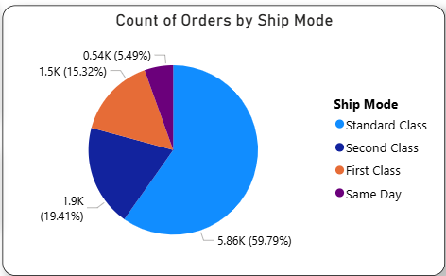
Understanding Of Visuals
Total Sales By Ship Mode
Count Of Orders By Ship Mode

Slide 8
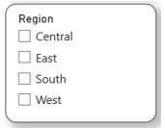
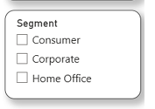

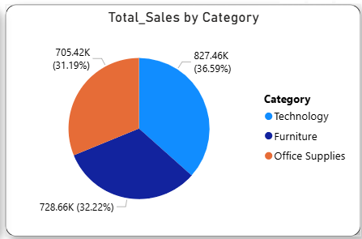
Understanding Of Visuals
Slicers Used:
Total Sales By Category

Slide 9
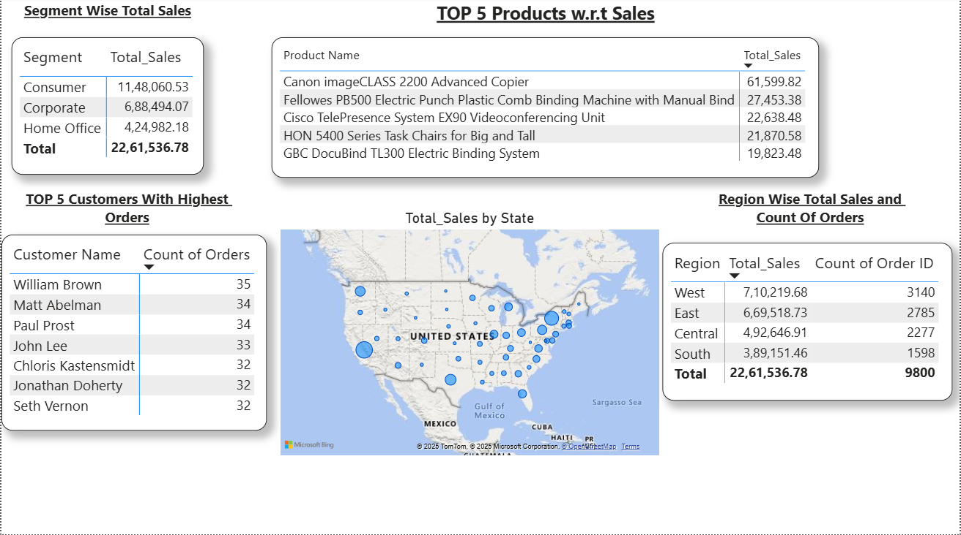
Overall Analysis Of Sales

Slide 10
Key Insights After Analysis
Segment Wise Total Sales was high for Consumer Segment and Second Highest was followed by Corporate and Home Office.
Highest sales was made by the product Canon image CLASS 2200 Advanced Copier.
William Brown is the highest ordered customer with 35 orders and following him comes Matt Abelman and Paul Prost with 34 orders and so on.
Region-wise Total Sales and the number of orders was high for West Region with a Total Sales of 7,10,219.68 and number of orders is 3.1K.
The Total Sales according to Order year is gradually increasing from 2016 to 2018 with a small dip in 2015 to 2016.
The Total Sales according to Ship mode is found that Standard Class is the only mode with Highest sales trend.

Slide 11
Conclusion
Power BI tool is a versatile tool that helps in visualising the data and draw key insights from it.
This tool is very much efficient in accessing various kind of file types and helps deliver quick insights.
In this Sales Data Analysis, Power BI played a crucial role in deriving the overall crucial drivers of the business.
With help of DAX measures and calculated columns, the work was made simple.

Slide 12
THANK YOU!!

